Slide 1

The Bill of Rights
Amendments IV-VI

Slide 2
Review…
The Bill of Rights
  First 10 Amendments
  Were passed in 1791
  Listed rights that protected all Americans
Amendment I: Freedom of Press, Assembly, Speech, Religion, and Petition
Amendment II: Right to Bear Arms
Amendment III: No Quartering of Soldiers is Allowed

Slide 3
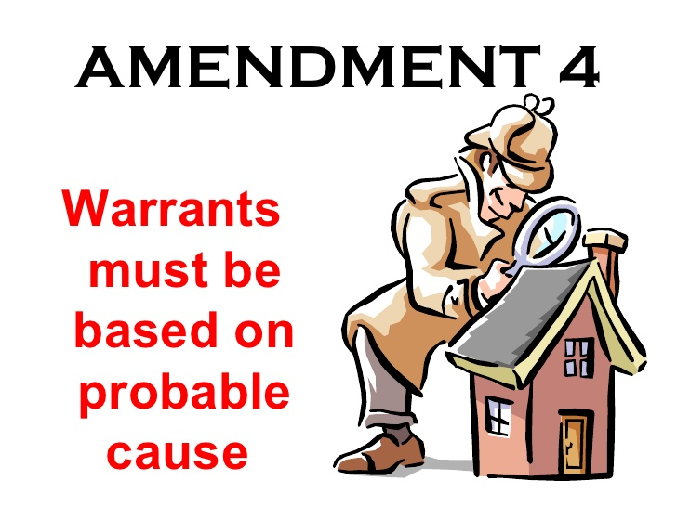
Amendment IV
Focuses on Search & Seizures
If you are convicted of a crime: evidence is needed to prove it
  The government MUST have a search warrant to enter your home & look for something
  This amendment protects us from being wrongly arrested or searched!

Slide 4
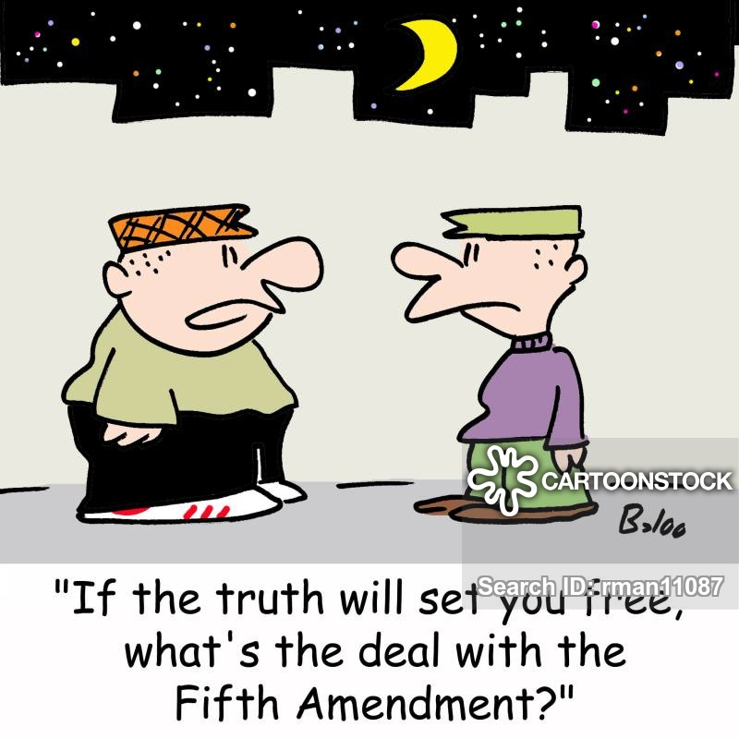
Amendment V
Gives basic legal protections
  No one can be tried with out an indictment (a formal charge) by a grand jury
    Grand Jury decides whether or not there is enough evidence to have a trial
  Protects against double jeopardy
    A person can not be tried for the same crime twice
  Guarantees due process of law
    The government can not take away someone’s life, liberty, or property, without going through the proper steps

Slide 5
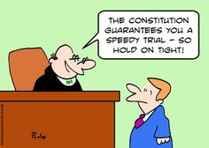
Amendment VI
The right to a fair, fast, & public trial
  People accused of a crime:
    Have the right to be present in court
    Have a lawyer represent them (even if they cannot afford one)
    Protects the rights of the accused

Slide 6
Zoom Meeting
Tomorrow @ 1:00 PM
  Your parents were sent the link, meeting ID, and password
    Make sure you use your real name or you will not be admitted
    Make sure your camera is on!
  We will discuss:
    DC Presentations
    Amendments VII-X
      Quiz on Wednesday
    Anything on your minds

