Slide 1

Amendments
XXII-XXVII

Slide 2
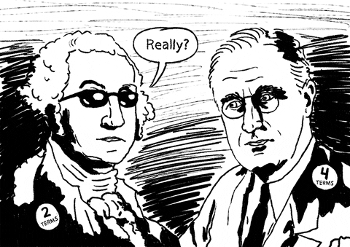
Amendment XXII
Ratified in 1951
Puts limit on how many terms a president may serve
G. Washington set precedent by only serving 2 terms or 8 years
  FDR ran for 4 terms

Slide 3
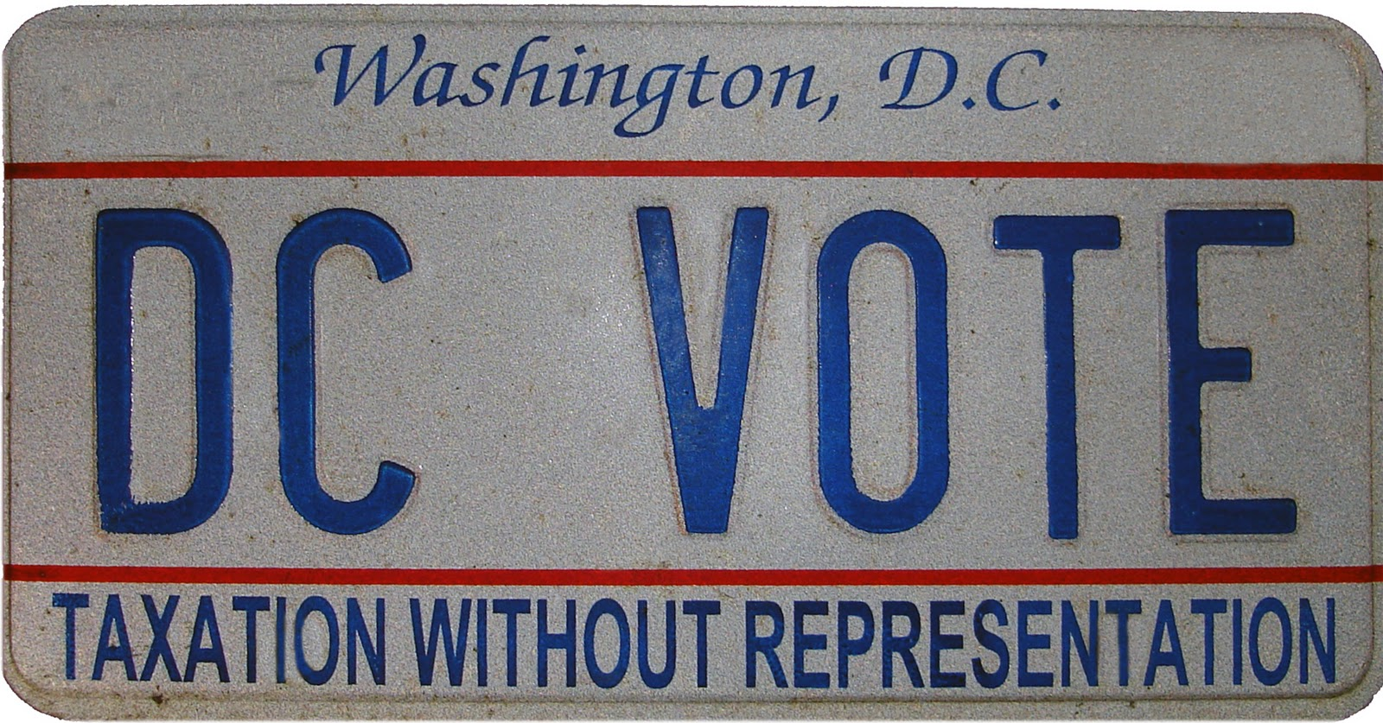
Amendment XXIII
Ratified in 1961
Gave citizens of Washington D.C. the right to vote in national elections

Slide 4

Amendment XXiv
Ratified in 1964
Prohibited charging a poll tax
  Many states would place tax on voting

Slide 5

Amendment XXV
Ratified in 1967
Allowed a new president to appoint a new Vice President
  This is in effect when a President dies in office
    JFK

Slide 6
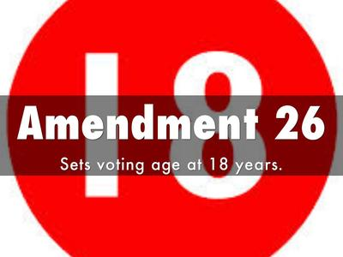
Amendment XXVi
Ratified in 1971
18 year olds given the right to vote
  Before the voting age was 21
    Vietnam War

Slide 7

Amendment XXVii
Ratified in 1992
Senators & Representatives can not change their salary until after the next election
  Was part of the Bill of Rights
    Was not put into place until 1992!!

Slide 8
We’re done…Now what?!
Continue working on your study guide
Rest of the week…review activities
  Zoom tomorrow @ 1:00PM
  Test either Friday or Monday

