Slide 1

Amendments
Xvi-XXI

Slide 2
Review
How does a Bill become a Law?
How is an amendment passed?
  If you can’t easily answer these questions…study this part!
  The test….is coming

Slide 3

Amendment Xvi
Ratified (passed) in 1913
Gave Congress the power to pass an Income Tax
  Each person is taxed according to how much money they make

Slide 4

Amendment Xvii
Ratified in 1913
Change in how Senators were elected
  Before Amendment...state legislatures would select senators
  After Amendment…the PEOPLE elected senators

Slide 5

Amendment Xviii
Ratified in 1919
Prohibition
  Banning the sale, distribution, manufacturing, and consumption of alcohol
  Took place in Progressive Era
    Alcohol was evil

Slide 6
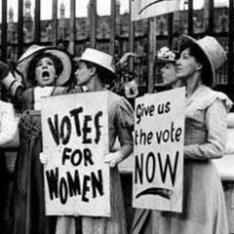
Amendment XiX
Ratified in 1920
  Women’s suffrage
    Another Progressive Era movement
    Women fought since the mid-1800s
    1st State to allow women this right
      Wyoming

Slide 7
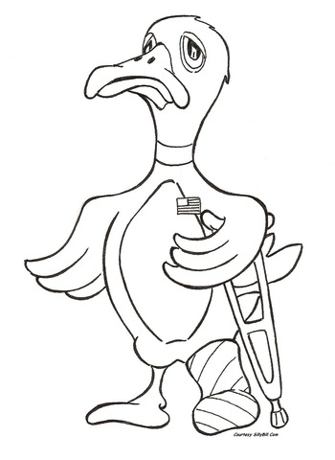
Amendment XX
Ratified in 1933
Changed dates when elected officials took office
  Before this Amendment…President took office in March
  Now…January 20th
  The period from November to January is known as LAME DUCK

Slide 8
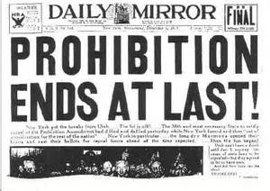
Amendment XX1
Ratified in 1933
  Repeal of Prohibition
    Repeal—Reverse
  Lack of enforcement
  Much opposition

Slide 9
Next Steps…
Complete your ½ page entry in your Primary Source Journal
Flip Grid…if you didn’t on Tuesday
WORK ON YOUR STUDY GUIDE!

