Slide 1
Character Archetypes
Mythology Unit

Slide 2

The Hero
Almost always the protagonist
The audience can relate to him/her
Leaves his/her familiar world to enter a new world where previous skills are no longer sufficient
The hero will save the day

Slide 3
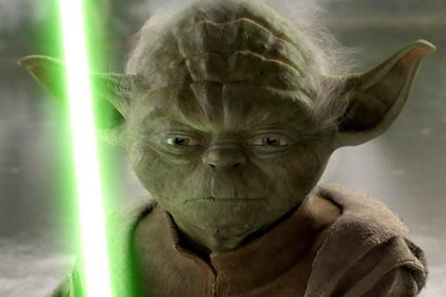
The Mentor
Shows up to give the hero a fighting chance
Instructs the hero how the new world works
May be reluctant to help the hero because they will leave comfort behind
Disappears when the hero is ready; leaving the hero to fight alone

Slide 4
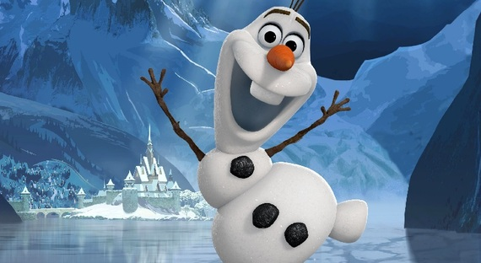
The ally
A loyal friend
Someone to carry the hero’s gear
Keeps the hero company
Gives the hero someone to interact with when he/she is alone
May help distract the hero from the journey

Slide 5
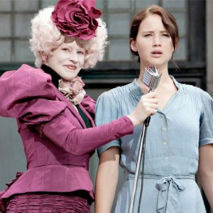
The herald
Appears in the beginning to announce the need for change
Catalyst that sets the adventure in motion
Might show the hero a glimpse of new/better life
Singles out the hero for a journey he/she wouldn’t otherwise take

Slide 6
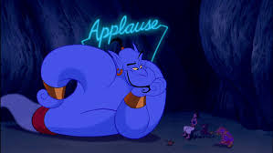
The Trickster
Adds fun & humor to the story
Gives the audience a break when things get tense or gloomy
Sometimes offers outside perspective and/or opens up important questions

Slide 7
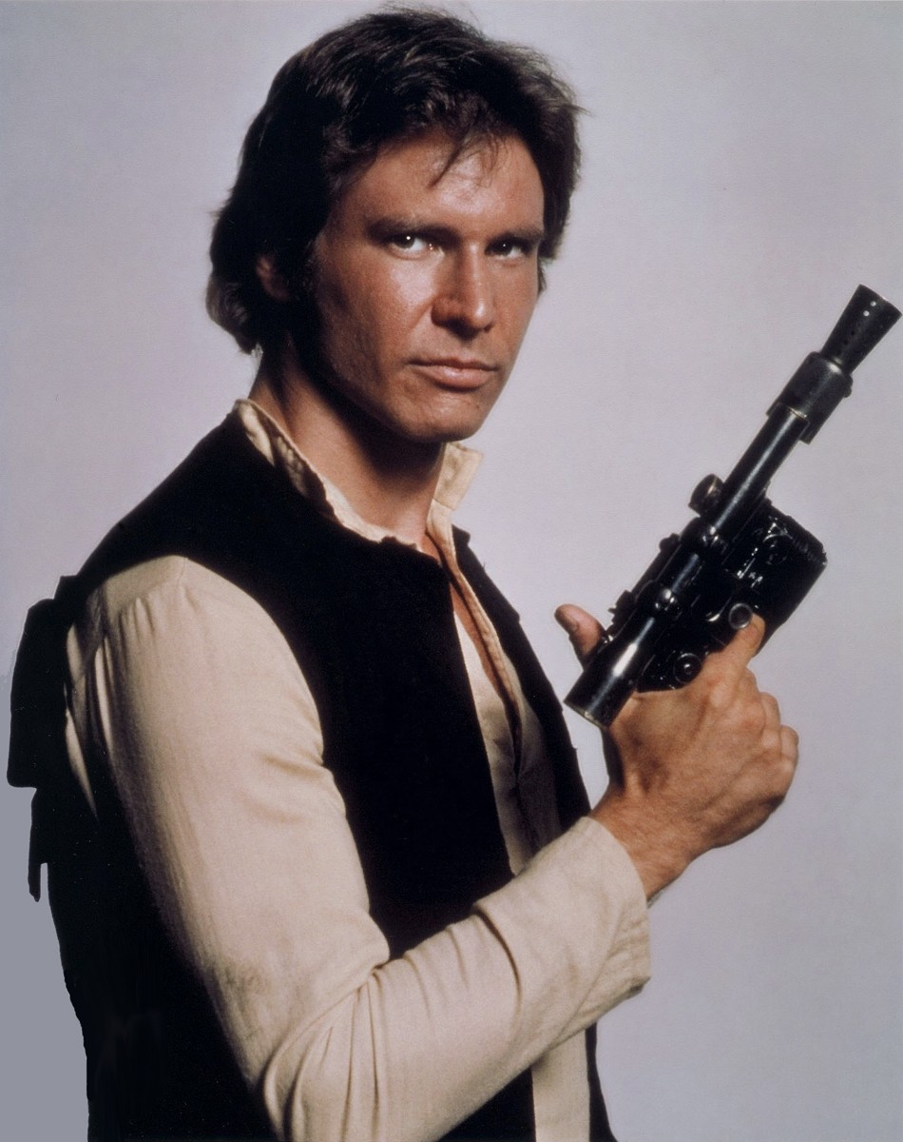
The shape shifter
Blurs the line between enemy & ally
May begin as an ally but betrays the hero at a critical moment
Sometimes the loyalty to the hero is in question

Slide 8

The guardian
Sometimes called the threshold guardian
Tests the hero before the ultimate battle or greatest challenge
Always block an entrance or border of some kind
The hero must prove his/her worth & Pass the guardian

Slide 9
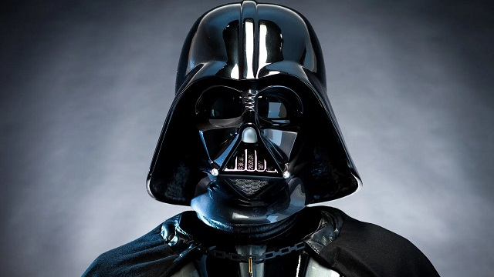
The Shadow
The villain in the story
Exists to create threat & conflict
Sometimes mirrors the hero in some way
Often a symbol of evil in contrast to hero’s goodness

