Slide 1

Strategies for the North and the south

Slide 2
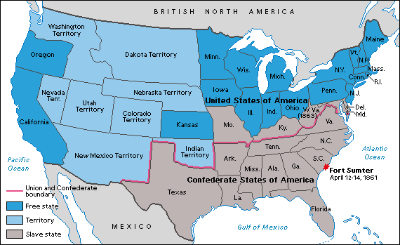
Map of the USA & Csa when the war began

Slide 3
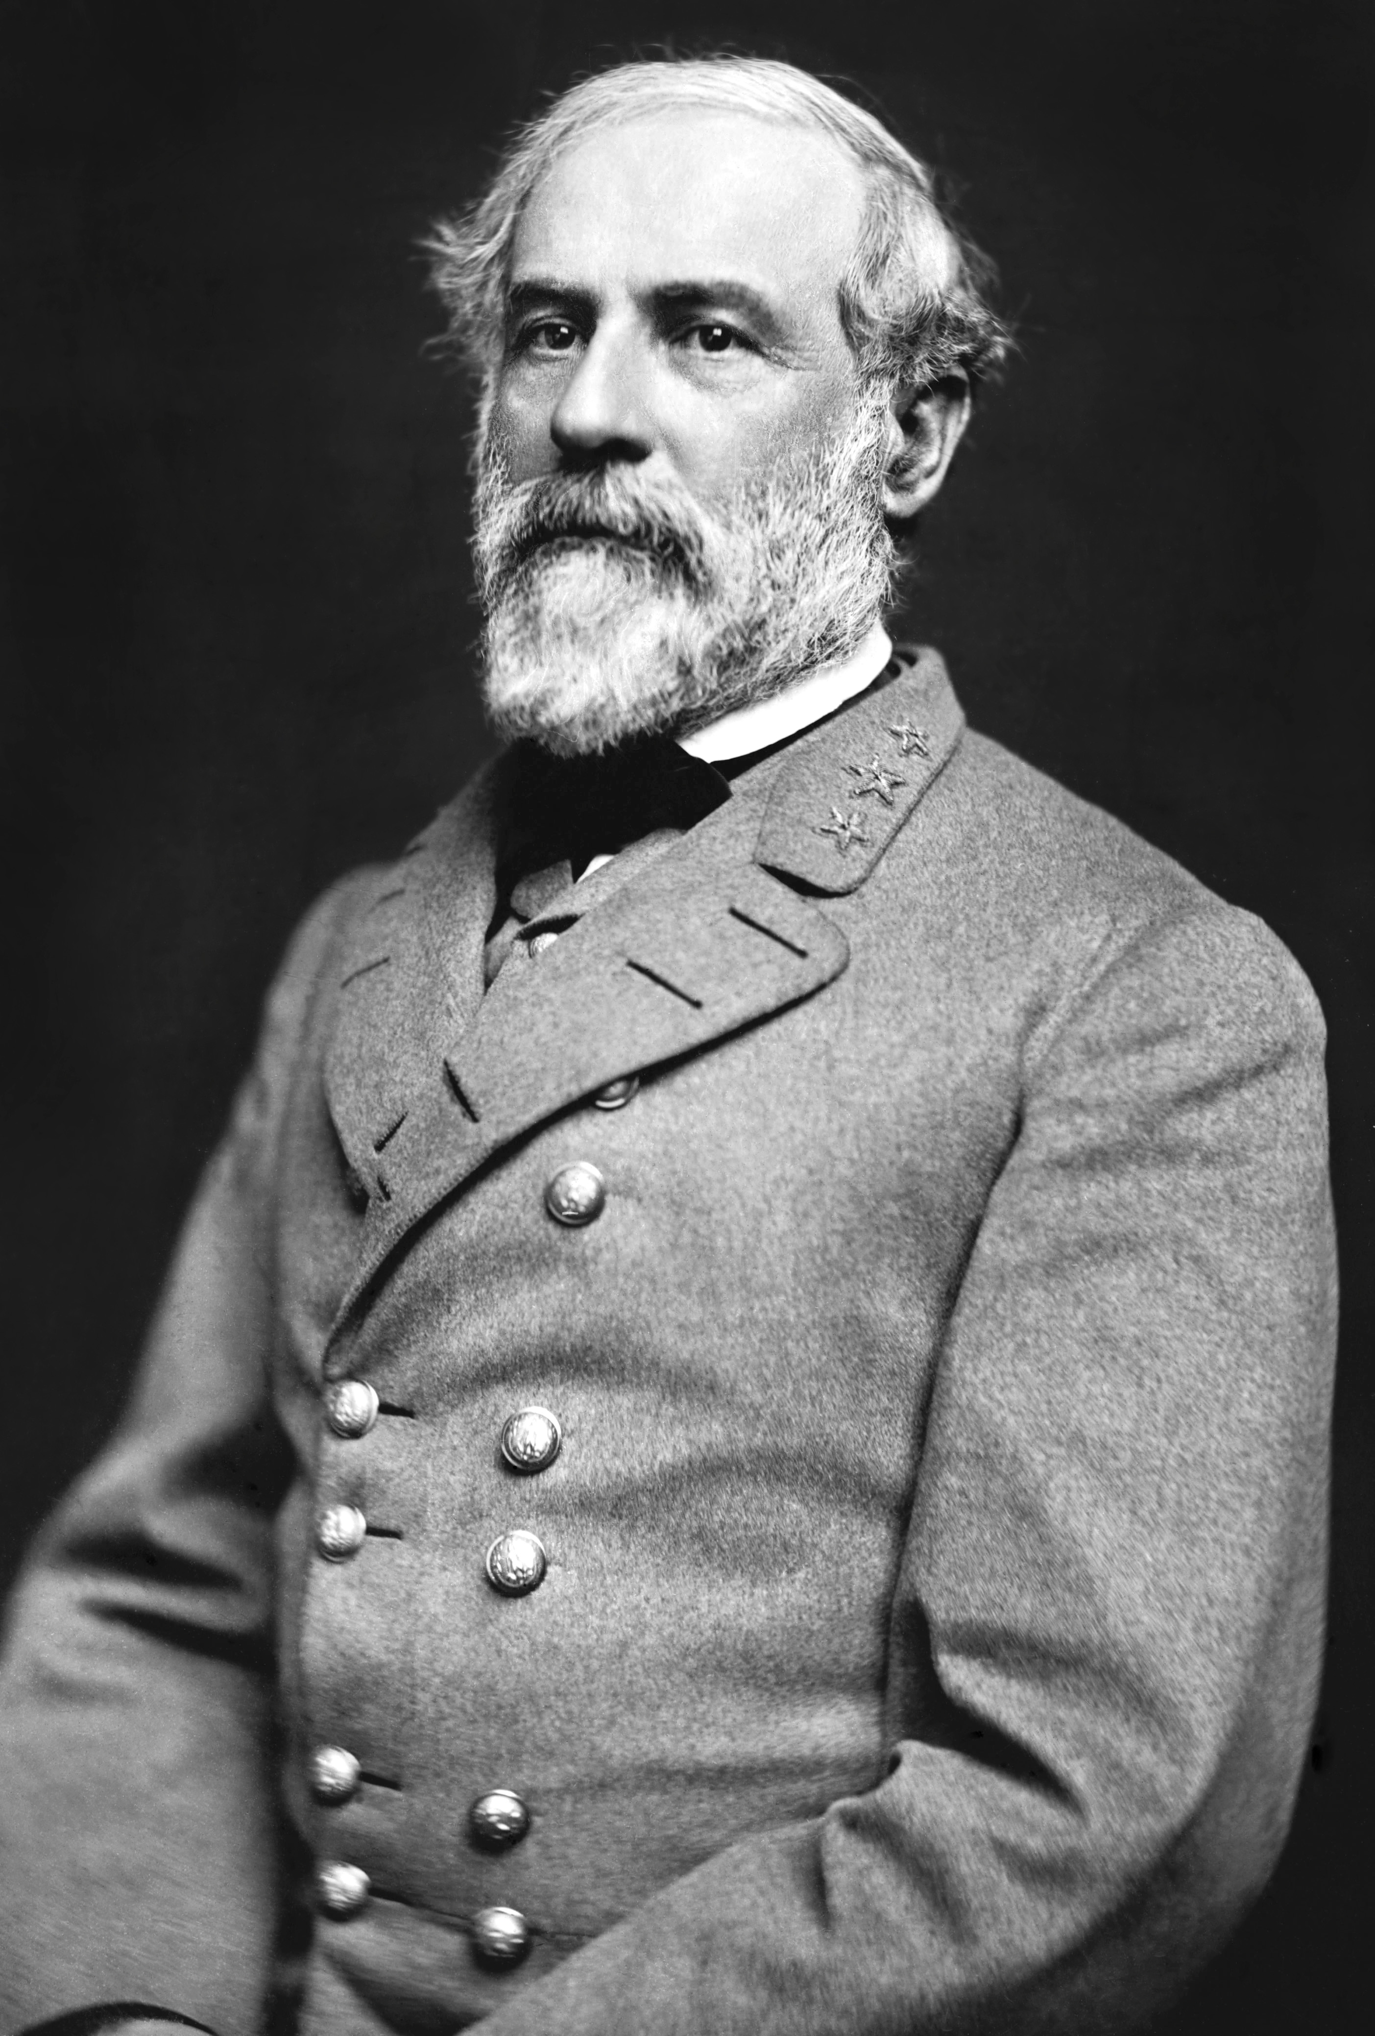
The South
Wanted the North to come and get them
  Their thought was…they broke away, if the North wants the South sooo badly they will come get them
Drag the war out
At some point win a battle in the North
Try and get a foreign ally (France or Britain)
Robert E. Lee

Slide 4
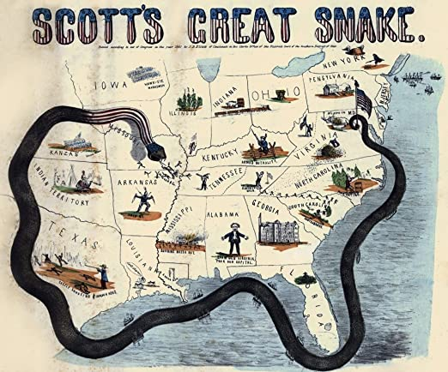
The North
Anaconda Plan
Blockade the South
Take control of the Mississippi River
Split the South from the Western lands
Take the Confederate Capital of Richmond, VA

