Slide 1

Strengths & Weaknesses of the U.S. & the Confederacy

Slide 2
Let’s compare the North and the South
Draw the following chart in your notebook. I would use a new page and turn it on it’s side. Make a chart with 3 columns and 11 rows.

Slide 3
Category | North | South
Other Names | Union, United States, Yankees, USA | Confederates, Confederate States of America, Rebels, CSA
Number of States | 23 | 11
Population | 22,000,000 | 9,000,000 (includes 3, 500,000 slaves)
Leadership | Abraham Lincoln | Jefferson Davis
Railroads | 75% of the nation’s railroads | 25% of the nation’s railroads

Slide 4
Gernerals | Uysses S. Grant George B. McClellan -Inexperienced | Robert E. Lee Stonewall Jackson -well trained -expeirenced
Capital | Washington D.C. | Richmond, VA
Army | 1,500,000 men | 1,000,000 men
Navy | Large army that grew larger as the war progressed | No navy at the beginning of the war
Cause for fighting | -Preserve the country -Free the slaves | -Maintain ”Southern way of life” including slavery

Slide 5
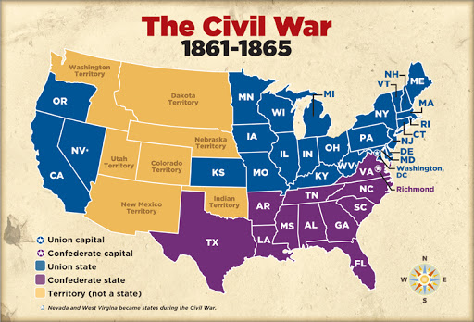
Map of the usa & the csa

