Slide 1

Shoguns & Samurai

Slide 2
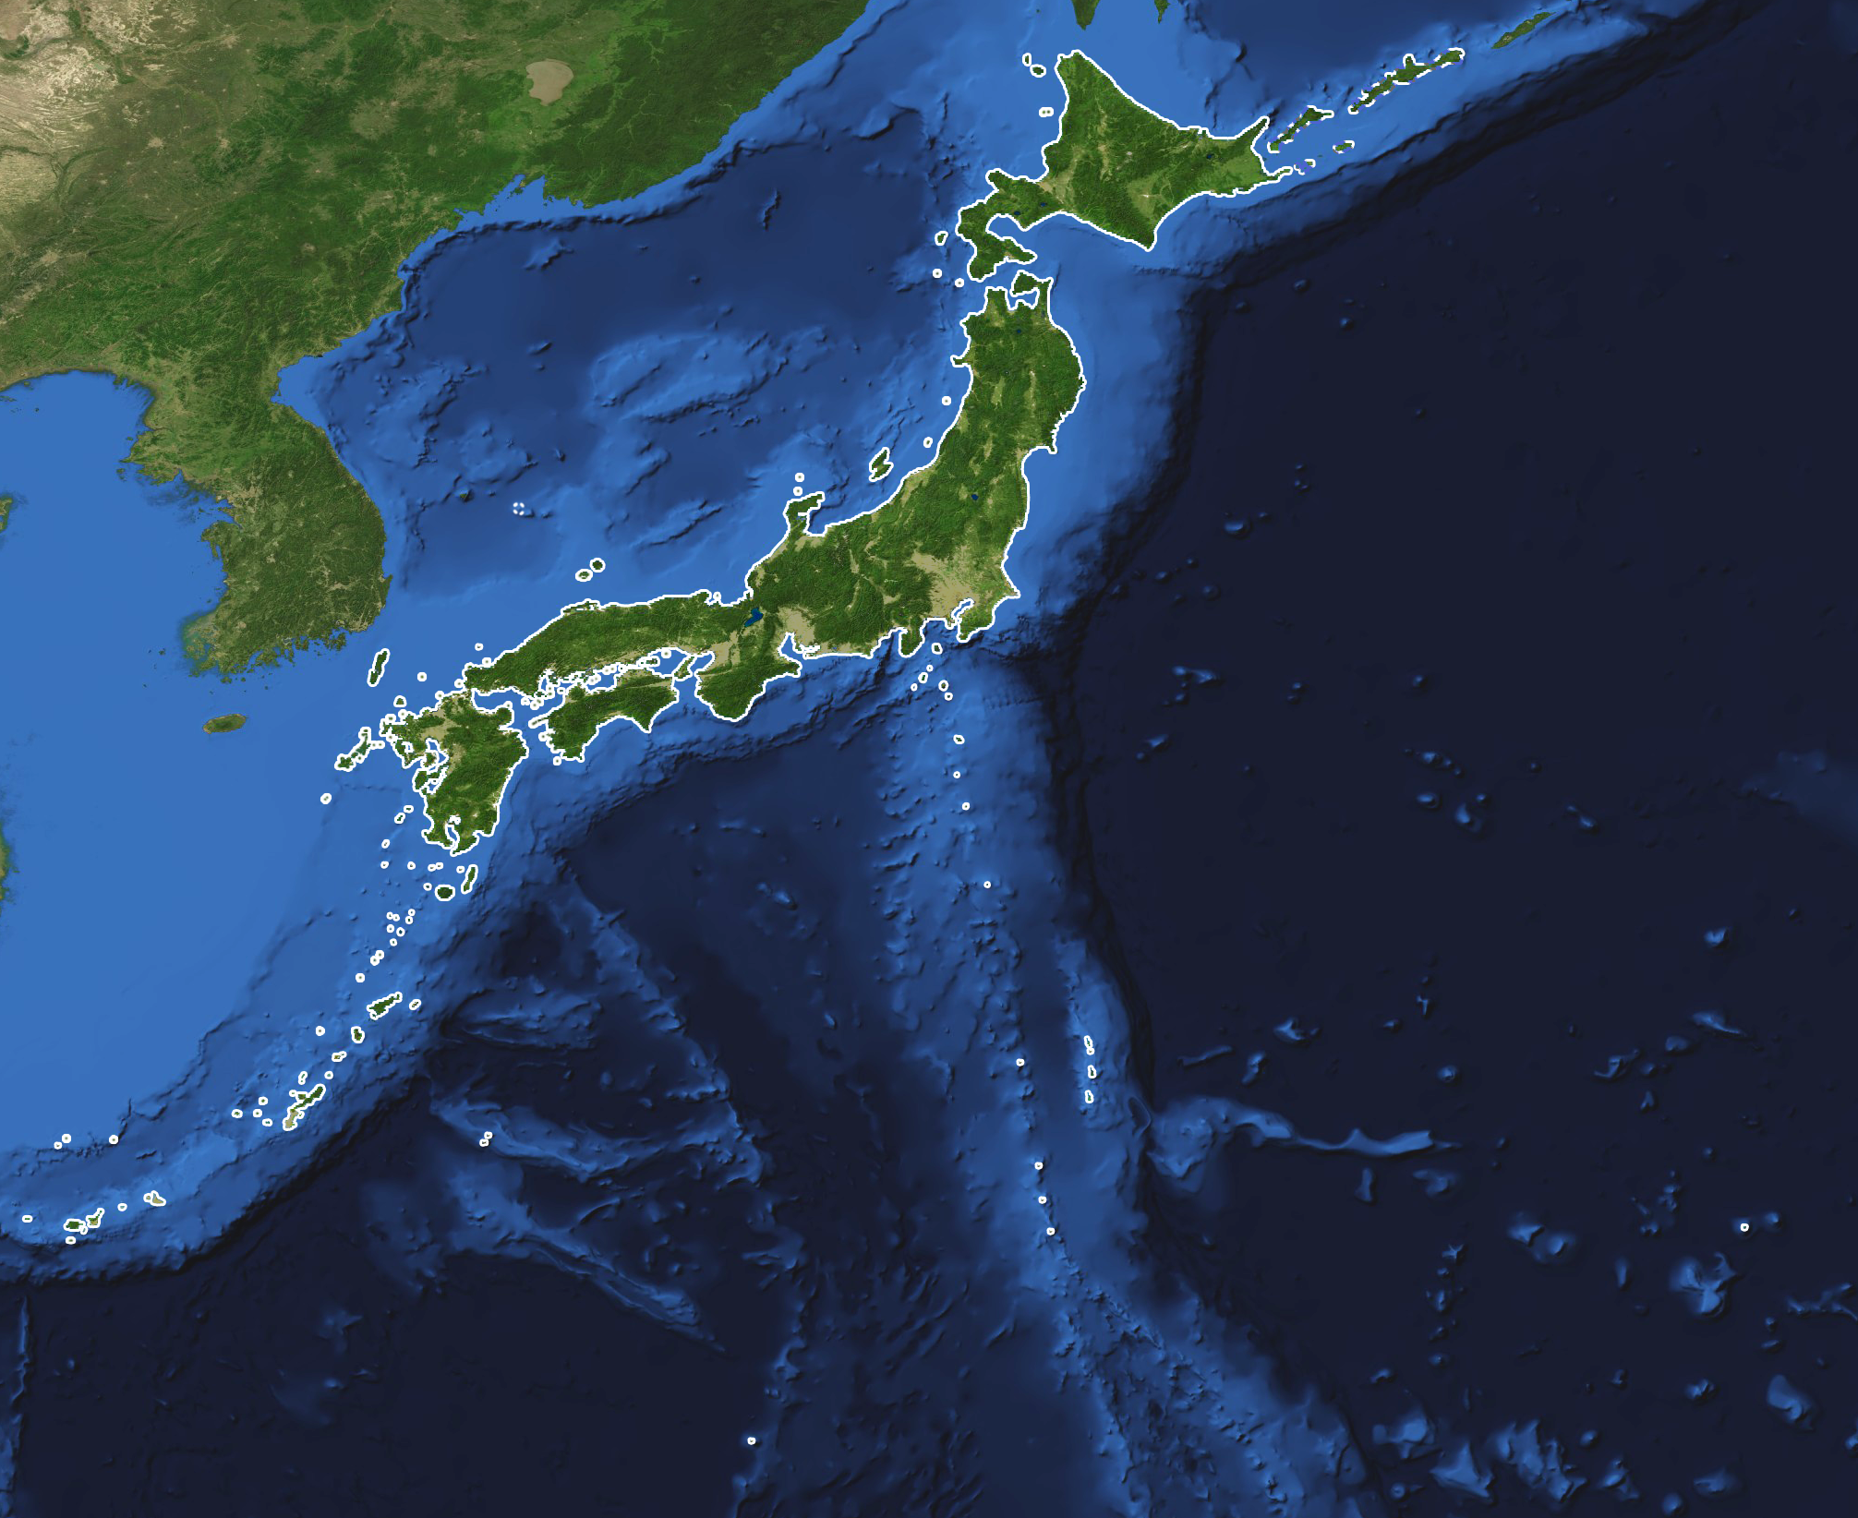
Review…
Japan is set on a chain of islands known as an archipelago
It is very mountainous

Slide 3
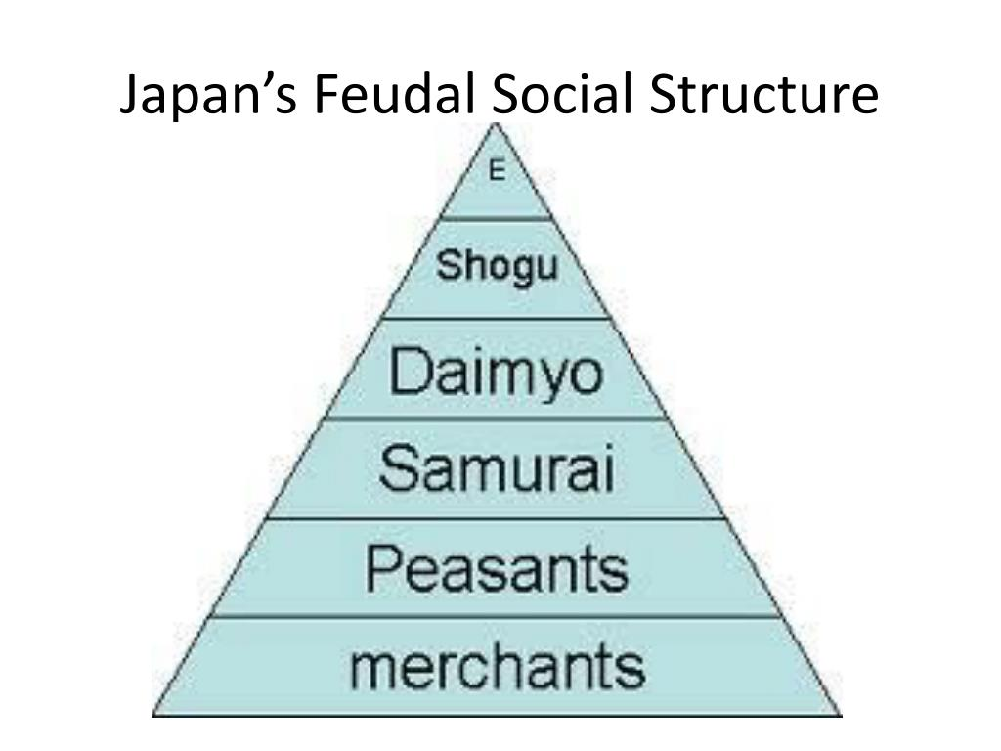
Social Structure
When looking at Medieval Japan, we will see a social class system
  Social Class System is how society is divided usually based on wealth
  Think of the social classes we’ve learned about…
    Egypt
    Rome
    India

Slide 4
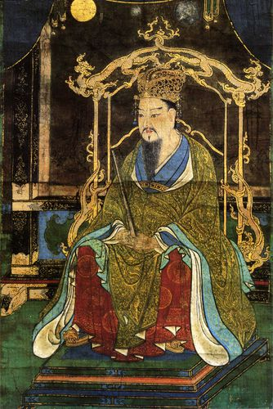
Emperor
Highest person in the Japanese class system
Power came from control of land and crops
  Appointed people to different jobs with in society
    These people could pass jobs down to other family members
    Were given land and farmers to work the land

Slide 5
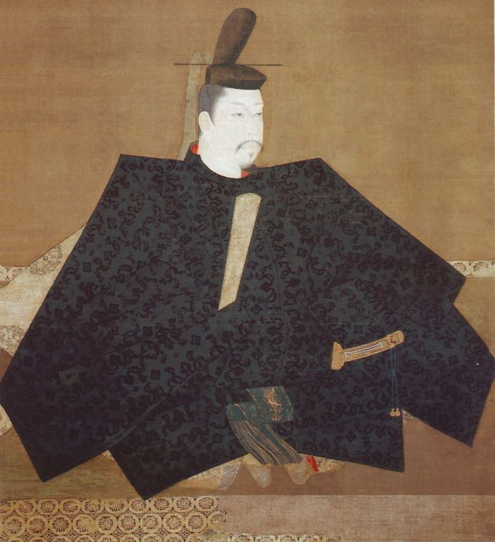
Shogun
Emperors became weak
  Many were young children and did not know how to rule
Commander of all the emperor’s military forces
  2 governments formed in Japan
  Emperor—power gone
  Military government

Slide 6
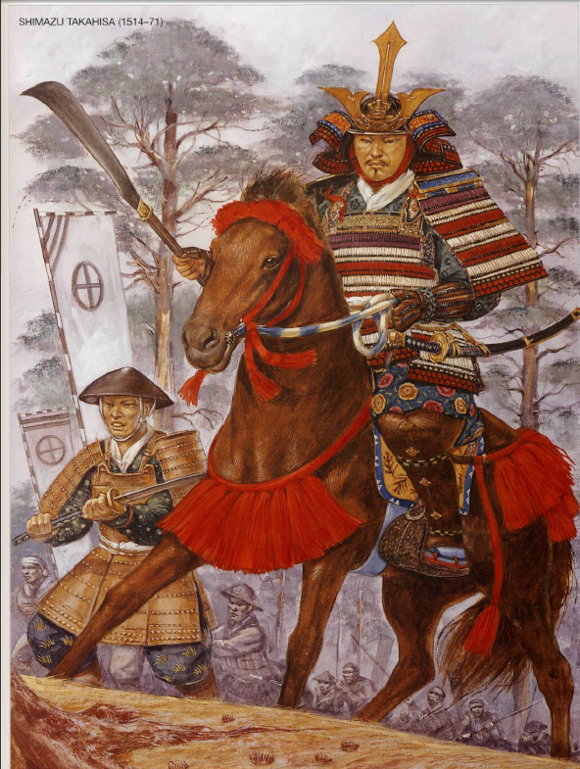
Samuari
Nobles formed private armies
  People who fought for nobles, received lands
Samurais fought on horseback with swords, daggers, bows/arrows
Lived by strict code (Bushido)
Must be loyal, brave, honorable
Did not care for money
Never wanted to be defeated

Slide 7
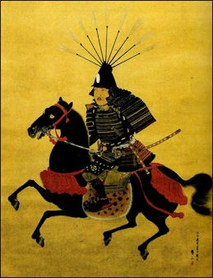
Daimyo
Powerful military lords
  Pledged loyalty to Emperor & Shogun
  Fought to protect THEIR OWN lands
  Samaurais would pledge loyalty to daimyo & daimyo would give land
    A type of Fedualism
      Lords & Vassals

