Slide 1

Elements of Mythology

Slide 2
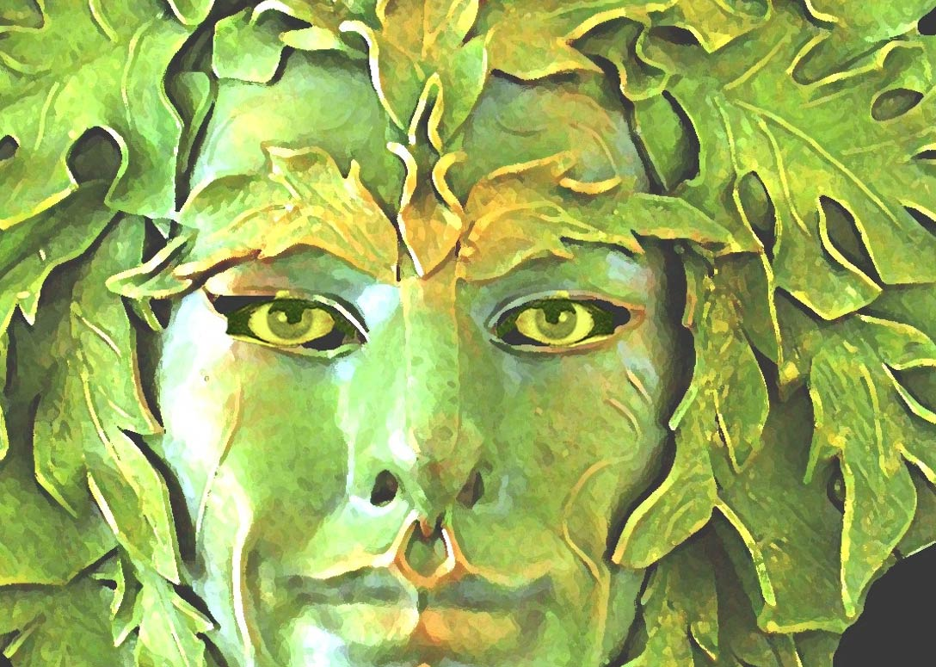
Explanation of Nature
Purpose of a Myth
  Explain something about the world, nature, or how something came to be
  Ancient people did not know about science…told these stories instead

Slide 3
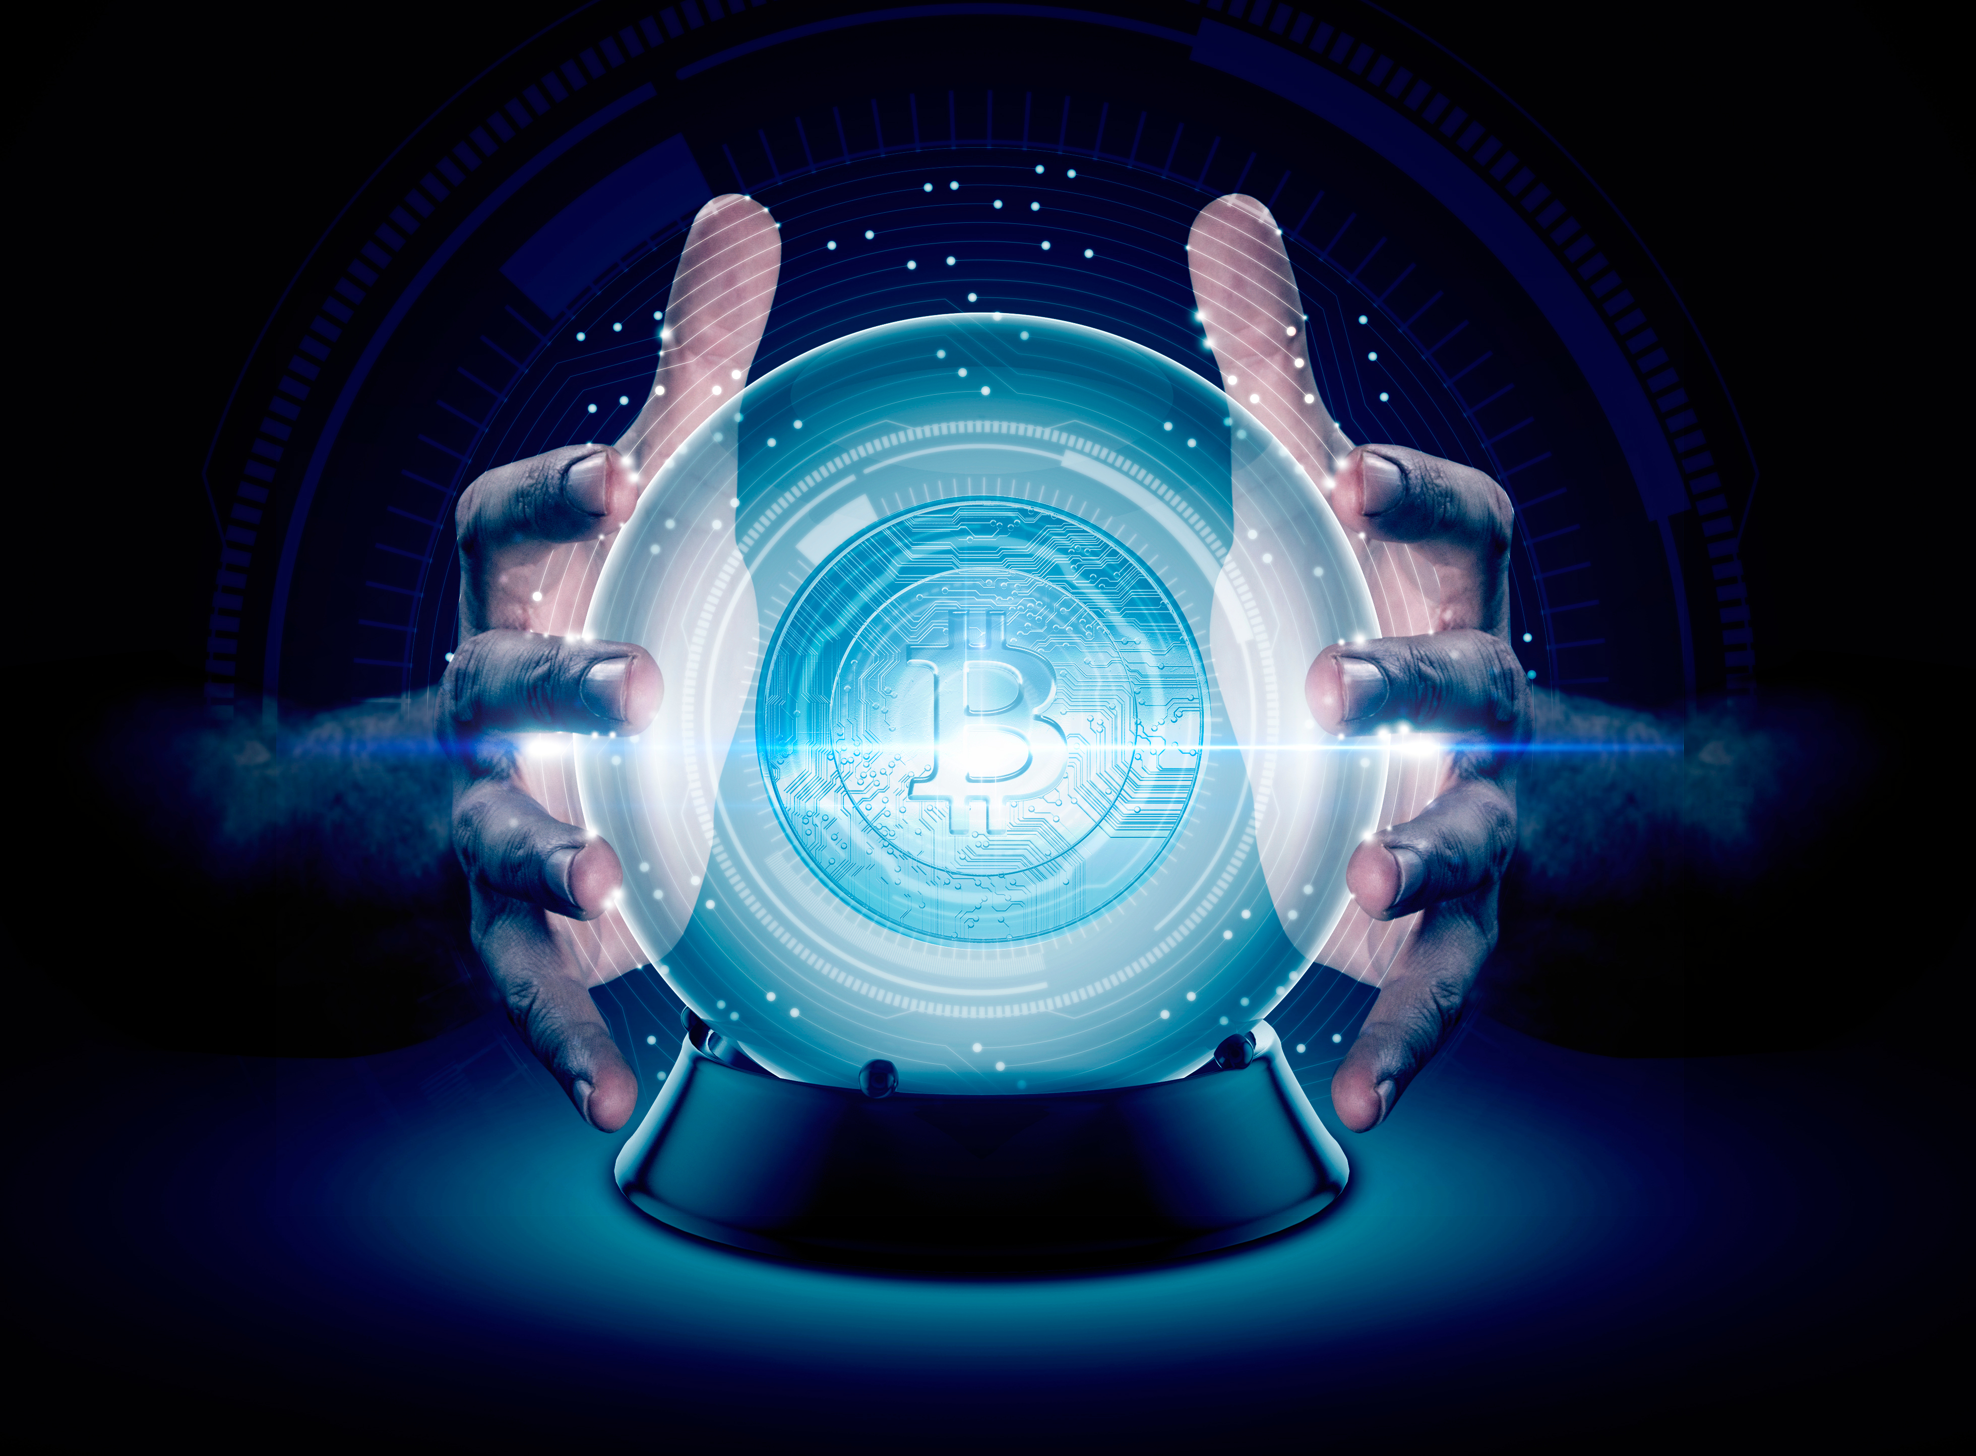
Fate & Prophecy
THEME
  Idea of fate and it’s power is a central theme in myths
  Some begin with a prediction
    Shapes actions and interactions of characters

Slide 4
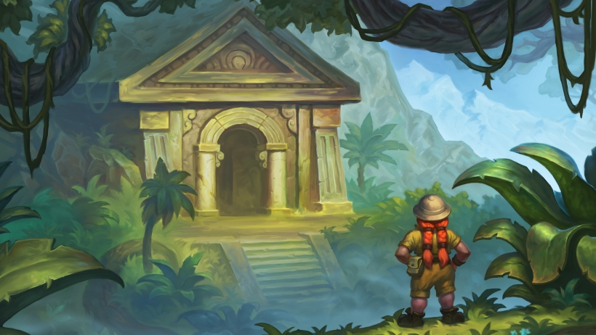
Quest or Task
PLOT
  Stories of characters who travel between worlds to complete a quest or task
    They may have to find someone or something
    May travel between living/present worlds and other worlds

Slide 5
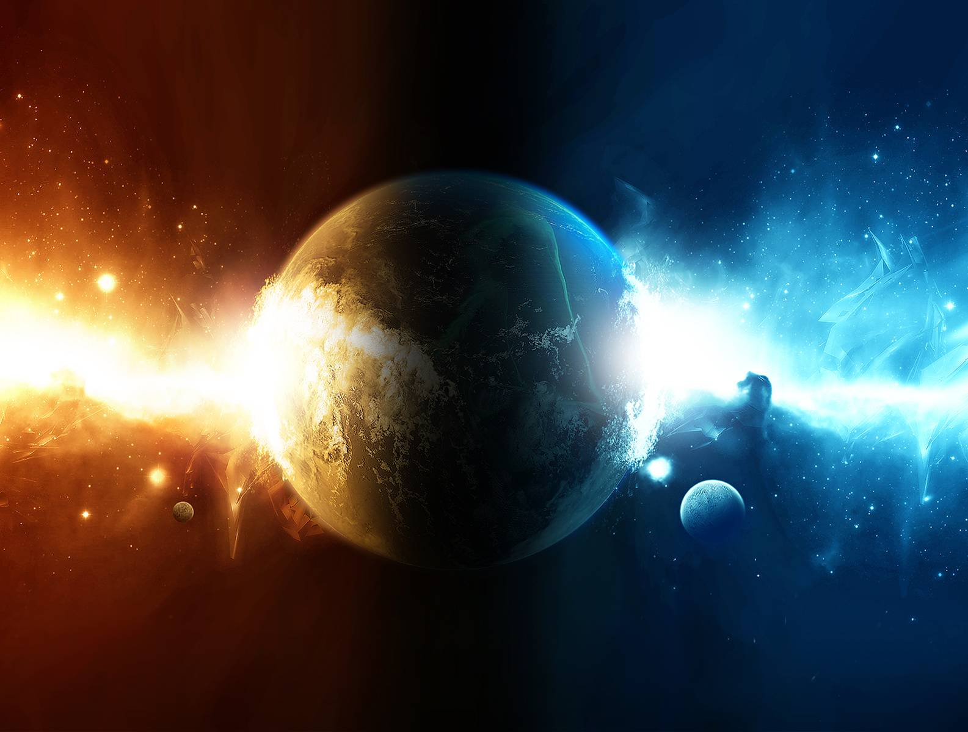
Opposing Forces
CONFLICT
  Tension between opposing forces
  Struggle for power between natural or supernatural forces, mortals and/or immortal characters

Slide 6
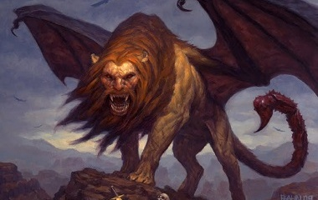
Supernatural or Nonhuman Characters
CHARACTERS
  May be human or non-human; mortal or immortal
  Supernatural beings may have human qualities or emotions
    Include gods, goddesses, and demigods
    May or may not have superpowers
    Gods may shape-shift by disguising themselves in our world

