Slide 1

The Road to the civil war
The Election of 1860 & Secession

Slide 2
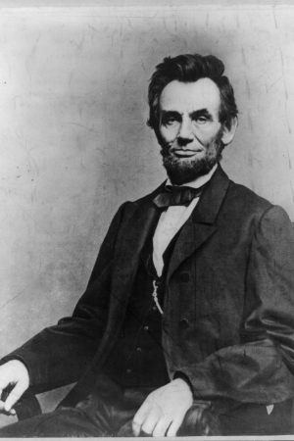
Election of 1860
Many candidates are chosen
  Abraham Lincoln is nominated for the Republican Party
  The Democrats are divided between 2 candidates
    Lincoln won the popular vote and won the election
Remember sectionalism?
  Voters voted based on where they lived
    Since the North had more people, Lincoln easily won over the Southern candidates.

Slide 3
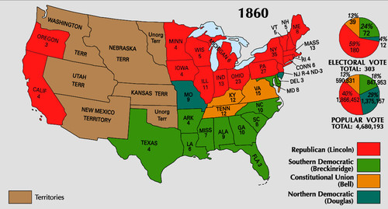
Election of 1860 Map

Slide 4
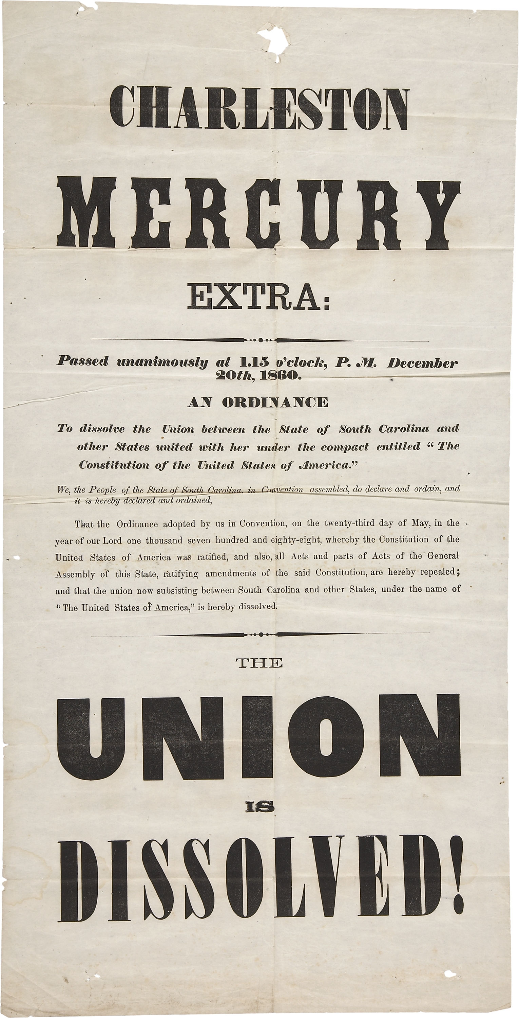
Secession
After Lincoln won the election in November, South Carolina decided it was time to leave
  Held a meeting in Charleston, SC to secede
    Secede—withdrawal from the Union
      After South Carolina, many Southern States followed

Slide 5
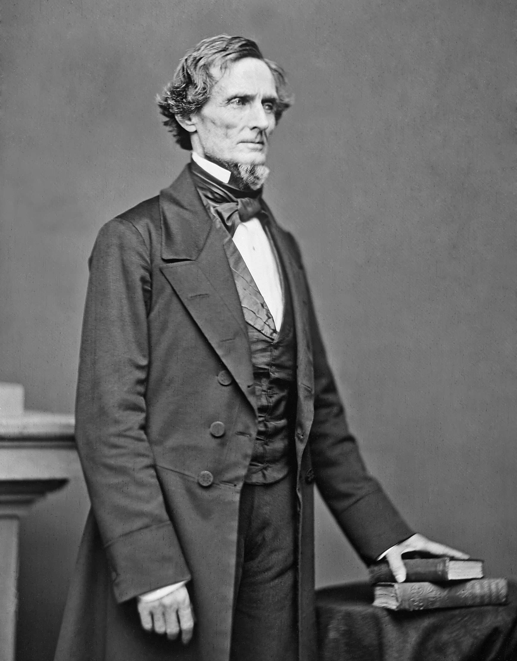
Confederate states of america
In total 11 states secede
  States rights
They form a new country known as the CSA or Confederate States of America
  Jefferson Davis becomes their president

Slide 6
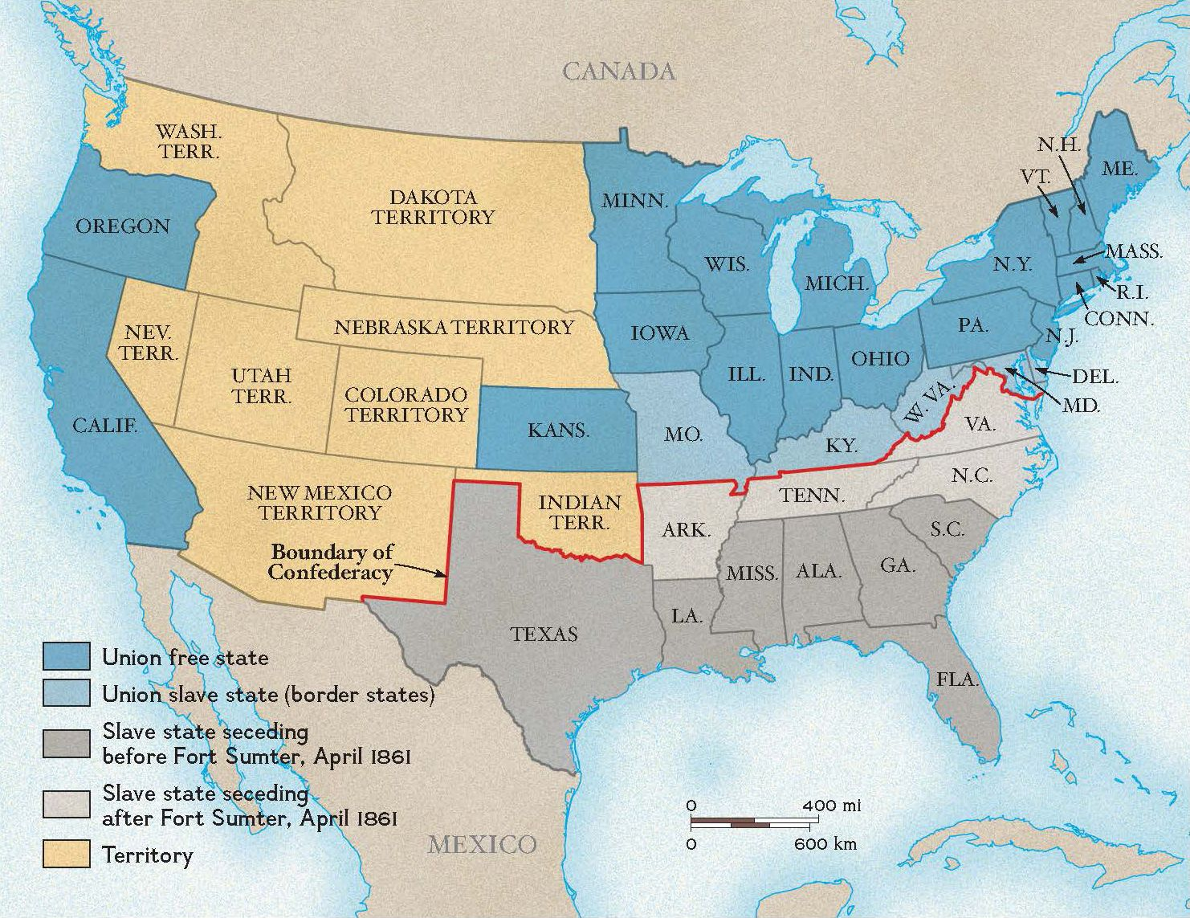
Seceding states, 1860-1861

